Slide 1


Intro to the business ..
Ding - an online business for high quality phone cases, mugs and customized apparels.
A start-up based out of Chennai, India and founded in April 2016.
Reliable online shopping
Great platform for showcasing talent by featuring their work
Customer Base: Potential customers belong to 18 -35 years’ age group
Current marketing platforms :
www.dingthestore.com

Slide 2
Initial Plan
Primary goals
Increase awareness
Drive more traffic to the website
3 Campaigns conducted
Cases
Mugs
Customizations
Budget allocation initial plan
Goals
Cases | Mugs | Customizations
70% =$175 | 15% = $37.5 | 15% = $37.5
Clicks | 150
Impressions | 2500
CTR | 1.5%

Slide 3
Initial Campaign Execution - Learnings
Campaigns | Campaign Type | Clicks | Impressions | CTR | Avg CPC | Cost | Avg Pos
Mugs | Search Network | 83 | 11,287 | 0.74% | $0.30 | $24.61 | 1.3
Cases | Search Network | 37 | 3091 | 1.20% | $0.35 | $12.91 | 1.2
Customizations | Search Network | 26 | 747 | 3.48% | $0.30 | $7.75 | 2.7
Total |  | 146 | 15,125 | 0.97% | $0.31 | $45.27 | 1.3
CTR was highest for Customized Ad groups in spite of the Least number of impressions
Least CTR for Mugs in spite of the large number of impressions – Competitor influence
Campaign type : Search networks only
Excluded “specific” names in the ad groups to avoid disapproval

Slide 4
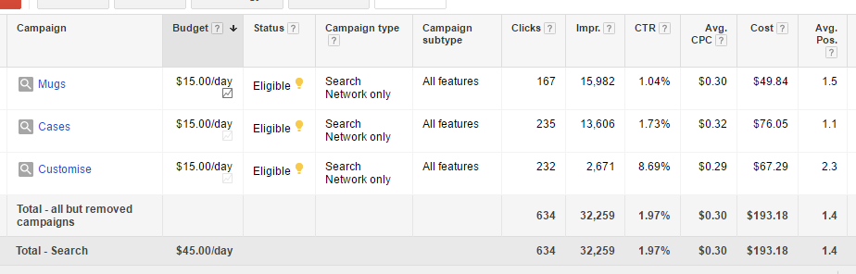
Updates ..
Paused the ads whose CTR was less than 2%
Exact match was preferred followed by broad match
Daily budget was changed to improve mugs and case campaigns

Slide 5
Summary
Total Clicks : 820
Total Impressions : 49562
CTR : 1.65%
Avg Position: 1.4
Campaign | Clicks | Impressions | CTR | Avg CPC | Cost | Avg Pos
Cases | 303 | 18739 | 1.62% | $0.32 | $97.97 | 1.1
Customize | 264 | 3519 | 7.50% | $0.29 | $76.89 | 2.4
Mugs | 253 | 27304 | 0.93% | $0.30 | $75.33 | 1.4
Total | 820 | 49562 | 1.65% | $0.31 | $250.19 | 1.4

Slide 6
Recommendations
Quality of the Landing Page
Compatible website on Mobile phones
Internal navigation within the website (Display an ad reference)
Diversity of individualized products
Call extensions for doubts regarding customization and reward policy

Slide 7
Thank You

